Slide 1

Presidential GDP
Group Members
Brittany Douville
Caite Green
Kevin Khan
Jeremiah Mergenthaler
Tyler Potts
Playground Link/

Slide 2
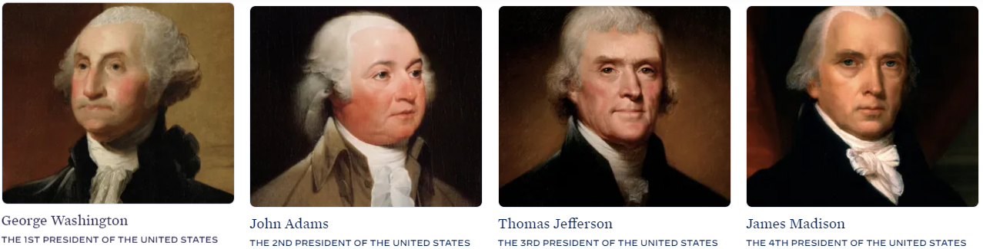
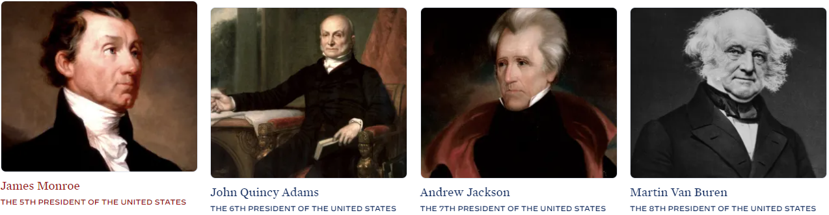
Overview
Stage 1
Ingest and clean
Clean, normalize, and standardize data set
Upload data to a database (postgress)
Stage 2
Develop and optimize model
Initializes Python script, trains, and evaluates a model
Model output of predictive power at least 75% classification accuracy or 0.80 R-squared (Single Model)
Model output of predictive power at least 75% classification accuracy or 0.80 R-squared (Multi-ouput Model)
Optimize model
show iterative changes
show change results in model performance
documented in either a CSV/Excel table or in the Python script
Overall model performance is printed or displayed at the end of the script
Stage 3
Visualize
- Create front end visuals with Streamlit
Deliverable: President
Input birth day, birth month and party:
Drop Down, reduces the chance for error and none guesses
Return predictions about:
What president you are most like?
What VP you would get along with best?
Will the economy be on and upswing or downswing?
What was the GDP growth?
Population growth increase (would you be a babymaker?)
In our final project for SMU Data Bootcamps our team has decided to use Data Model Implementation and Optimization to try and predict President.
Would the US be prosperous?
Can the model output predict classification accuracy equal to or higher than 75% or with an 0.80 R-squared?

Slide 3
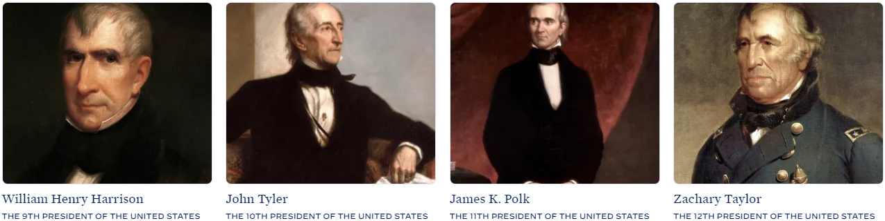
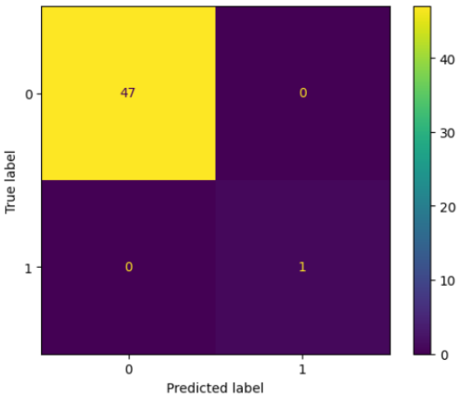
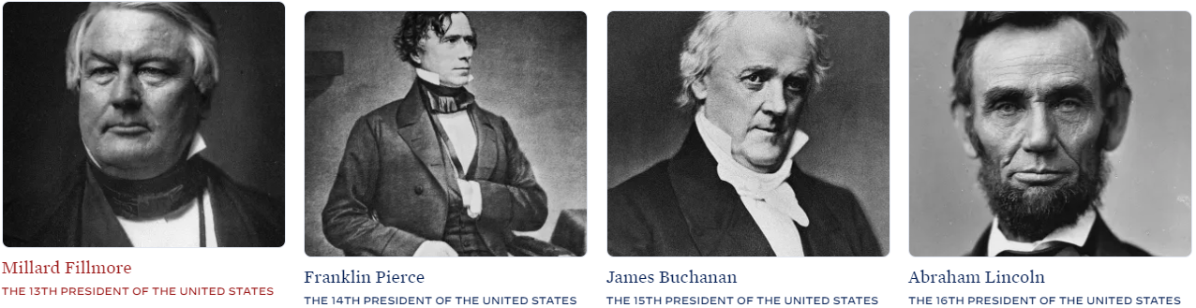
Single Output Model
The model used for the single output was Classifier Logistic Regression

Slide 4
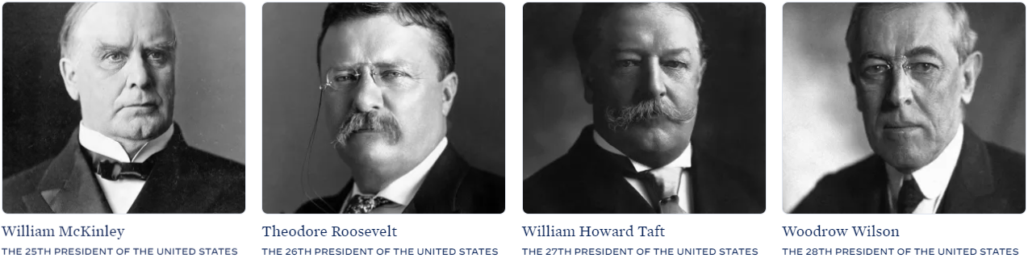
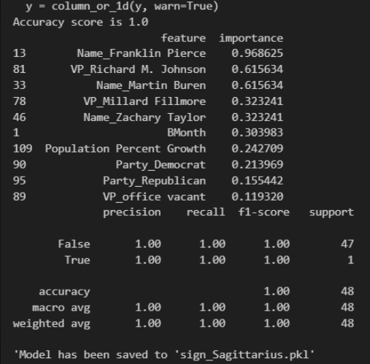
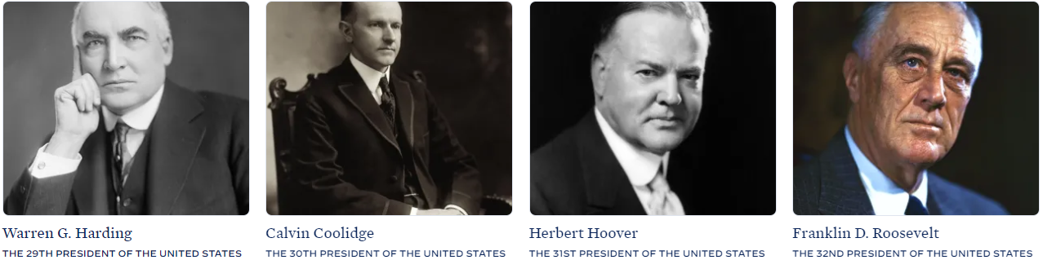
Most Important Features
**Based on the input of Sagittarius

Slide 5
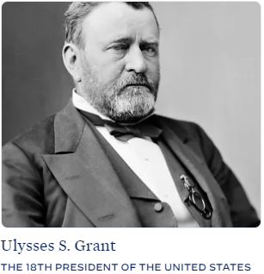
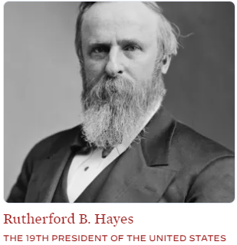
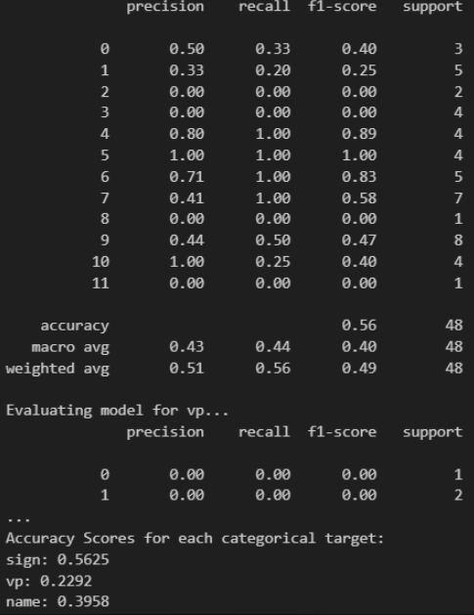
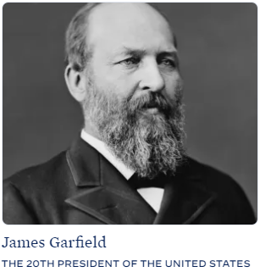
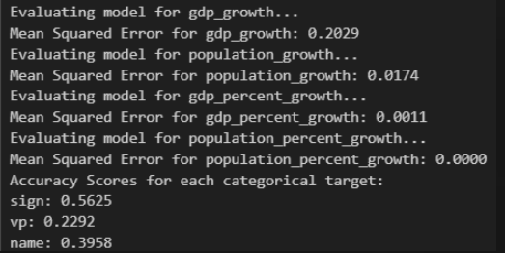
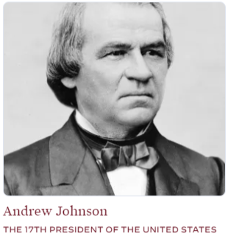
Multi-Output Example Back End
The models used for the multi-output were:
multi_output_classifier = MultiOutputClassifier(LogisticRegression())
multi_output_regressor = MultiOutputRegressor(RandomForestRegressor())
Fun fact
We were able to use label encoder on the categorical labels and then decoded them in the app.

Slide 6
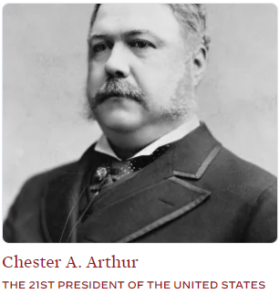
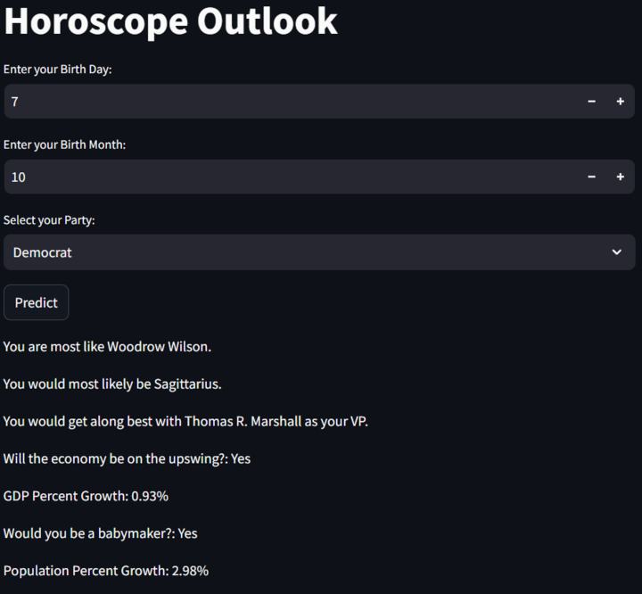
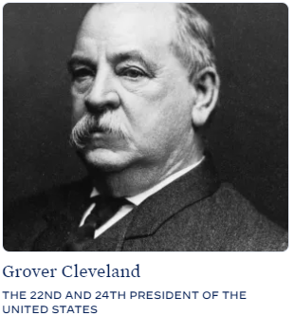
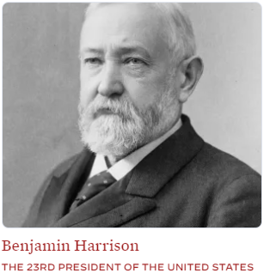
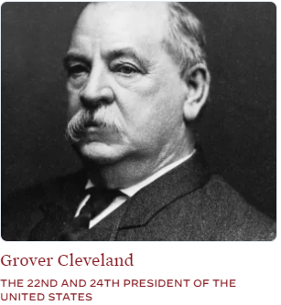
Multi-Output Application
Requires the user to enter their
Birth date
Birth month
Party affiliation
Click predict

Slide 7
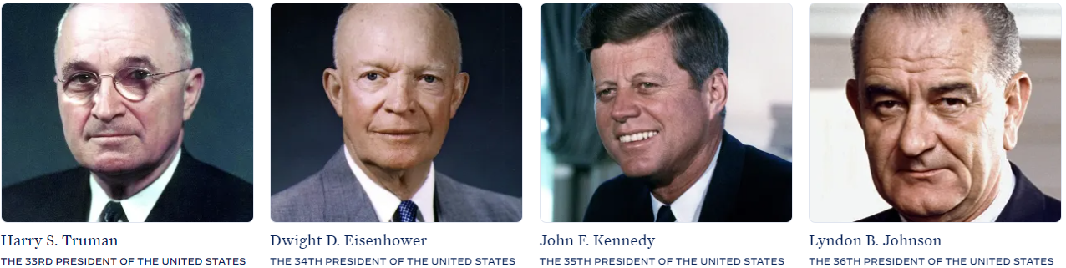
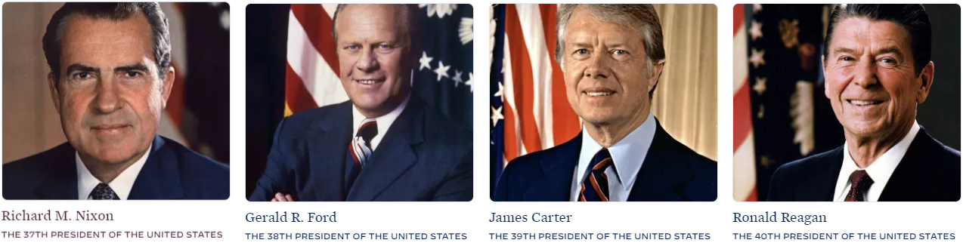
C
H A
L L
E
N
G
E
S
Finding data
Cleaning data with middle names
Finding data that showed term years all the way to president George Washington
Finding GDP Data that included information the way back to president George Washington
Converting dates from prior 1900’s
Determining what our X’s and y’s were.
Data sets had both categorical and numerical values

Slide 8
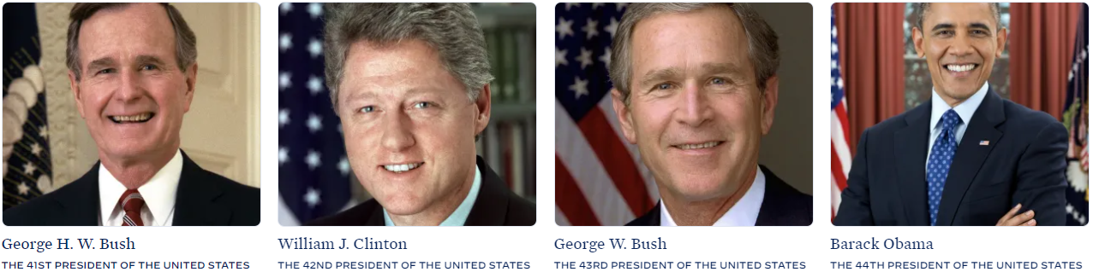
Limitations
Data set is on the small side, however still able to make a prediction that changes
Prediction are at a lower accuracy than what we originally thought on the Multi-Output Model
Most common president is Theodore Rosevelt, Woodrow Wilson, and John Adams
Model over fits when using the single input single out put (Single Output Model)
Comparisons are not correlated
Your success as a president is not correlated with you birth month or birth day.
Could not use the data from the actual US GDP.

Slide 9
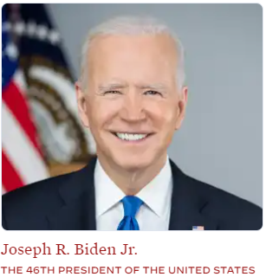
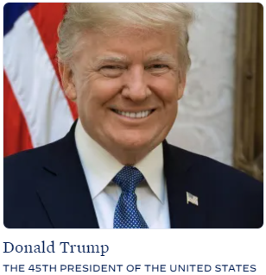
References/Sources
https://csvbase.com/roblillack/birthdates-of-us-presidents?op=gt&n=40
https://github.com/datasets/gdp-us/blob/master/year.csv
https://www.theguardian.com/news/datablog/2012/oct/15/us-presidents-listed#data
https://docs.google.com/spreadsheets/d/1dxg4mIyu02WaccBMS3JjhtQ3E0L4WrqfIf8oApJkpmw/edit?gid=0#gid=0
https://chatgpt.com/
https://www.measuringworth.com/datasets/usgdp/result.php
https://www.whitehouse.gov/about-the-white-house/presidents/git
https://www.kaggle.com/datasets/atmcfarland/historical-us-president-physical-data-more
https://smartpolitics.lib.umn.edu/2010/02/15/presidents-day-special-the-ast/
https://www.loriferber.com/research/presidential-facts-statistics/presidential-birthdates.html?srsltid=AfmBOopklqlRnov8DKpRGGZN4pRIUH3-x7FH5YpBd1axli-Rm07hxeyH
https://stackoverflow.com/
https://astrolibrary.org/us-presidents-table-zodiac-signs/

Slide 10

Is it Cute??

